Slide 1






OPPO ColorOSHack 2023
BUDGET
BUDDY
Smart Money, Happy Life
Presented By
BITS N BYTES

Slide 2









TEAM INTRODUCTION
Abdullah Nafis
3rd Year | BSc in Computer Science
(Graphics & Multimedia Software)
Universiti Teknologi Malaysia
nafis20@graduate.utm.my
Maria Taskin Aumanee
3rd Year | BSc in Computer Science
(Software Engineering)
Universiti Teknologi Malaysia
mariataskinaumanee2001@gmail.com
Tasmiah Sarif Nayna
4th Year | BSc in Computer Science
(Software Engineering)
Universiti Teknologi Malaysia
tasmiahnayna@graduate.utm.my
Labib Hasan
3rd Year | BSc in Computer Science
(Software Engineering)
Universiti Teknologi Malaysia
labib20@graduate.utm.my
A K M Shafin Alam
3rd Year | BSc in Computer Science
(Software Engineering)
Universiti Teknologi Malaysia
alam20@graduate.utm.my

Slide 3
THE PAIN POINT/PROBLEM IN THE MARKET
Personal financial management is increasingly complex in the modern world due to various expenses, bills, loans, and mortgages.
Existing banking and budgeting apps lack integration, requiring users to switch between multiple apps for effective financial management.
The absence of customized financial advice tailored to individual situations leads to hurdles and costly mistakes for users.
Many users struggle with tracking their expenses, creating budgets, and calculating loan payments in a simplified and user-friendly manner.

Slide 4
THE SCENARIO
Aminah is an employed woman in her mid-30s who is having difficulty managing her funds. She keeps track of her costs in one app, pays her bills in another, and calculates her loan repayments in yet another. Her monthly process consists of manually entering spending into one app, then logging in into her bank account in order to pay bills, and finally estimating the impact of an expected loan using another calculator app.
Aminah struggles with this separate method since it is time-consuming, prone to errors, and lacks an in-depth knowledge of her financial situation. She aspires for a one-stop solution that incorporates cost tracking, bill payment, and loan computations, providing her with an in-depth analysis of her money and helping her to make wise financial choices.

Slide 5
THE SOLUTION
We plan to provide an all-in-one solution for customers like Aminah, simplifying spending monitoring, bill payment, and loan computations within a user-friendly platform, resulting in a seamless financial management experience. Aminah's expenses will be easily recorded and categorized. Using machine learning, the app will evaluate Aminah's spending habits, income sources, and financial goals to provide personalized guidance and recommendations, guiding Aminah towards her financial goals.

Slide 6
INTRODUCING
OUR APP

Slide 7



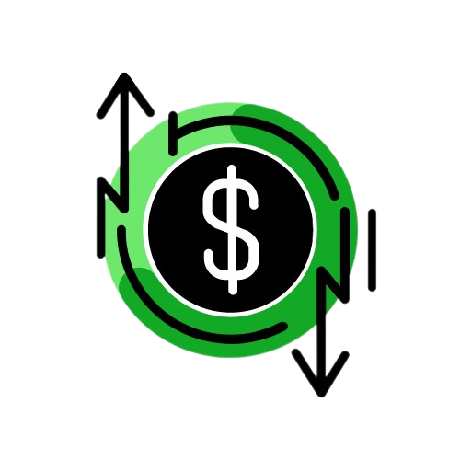

Slide 8
APP DESCRIPTION
BudgetBuddy strives to make personal budget management easier and more efficient. The OPPO phone application is intended to give users with a comprehensive set of tools to assist them in gaining control of their financial affairs. BudgetBuddy will be primarily concerned with retrieving transactions from users' bank account messages, categorising spending, budgeting, goal setting, and offering monthly reports and recommendations.

Slide 9
MAIN FEATURES
Transaction Message Integration:
BudgetBuddy will integrate with users' bank accounts and automatically fetch transactions from messages and notifications.
Expenses Categorization:
The app will automatically categorize expenses into predefined categories (e.g., groceries, entertainment, bills) and allow users to customize categories.
Budgeting:
BudgetBuddy will enable users to set monthly budgets for various expense categories.

Slide 10
MAIN FEATURES
Goal Setting:
BudgetBuddy will create a personalized plan to help users achieve these goals by analyzing their income, expenses, and budget.
Monthly Report and Recommendation::
At the end of each month, users will receive a detailed financial report summarizing their income, expenses, and savings.
OPPO Wallet:
BudgetBuddy will seamlessly integrate with popular E-wallets, allowing users to manage their digital wallet transactions alongside their bank transactions.

Slide 11
OUR APP’S
HIGH FIDELTY
PROTOTYPE

Slide 12
Demo Video:
https://youtu.be/8_VT0Rtg0A4
Prototype Live View Link:
https://www.figma.com/proto/gqPPWdUitNibFMTtkTKGCw/Untitled?type=design&node-id=104-215&t=wiFXX6HUweqlZJON-1&scaling=scale-down&page-id=0%3A1&starting-point-node-id=1%3A161&mode=design
Demo of Home Screen:
https://www.loom.com/share/7b9c6c7f79414d628824caf04d191263?sid=b299c47b-f584-4a9e-9836-1cb977c393f1
Demo in a Simulation Scenario:
https://youtu.be/kIuC77E_qHs

Slide 13

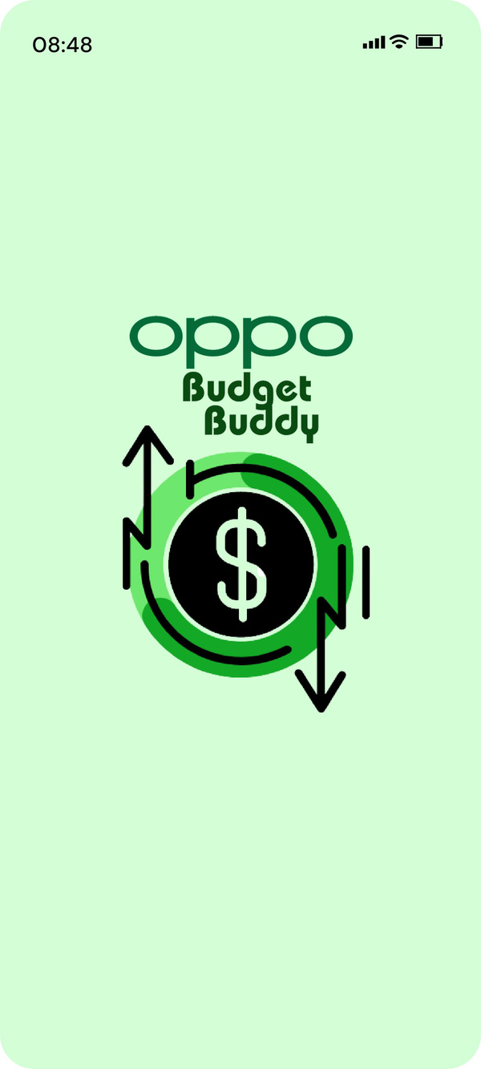
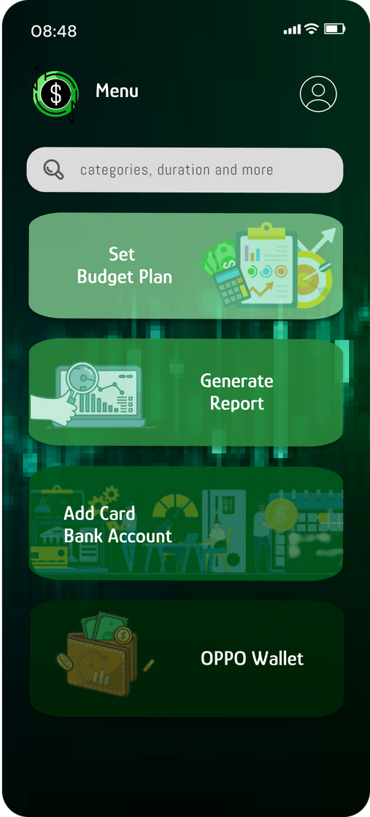

Screen 1 is the opening page which contains the official BudgetBuddy Logo.
Screen 2 is the screen of Set Menu. It contains four main features that our app offers.
Set Budget Plan
Generate Report
Add Card/Bank Account
OPPO Wallet
Screen 1
Screen 2

Slide 14
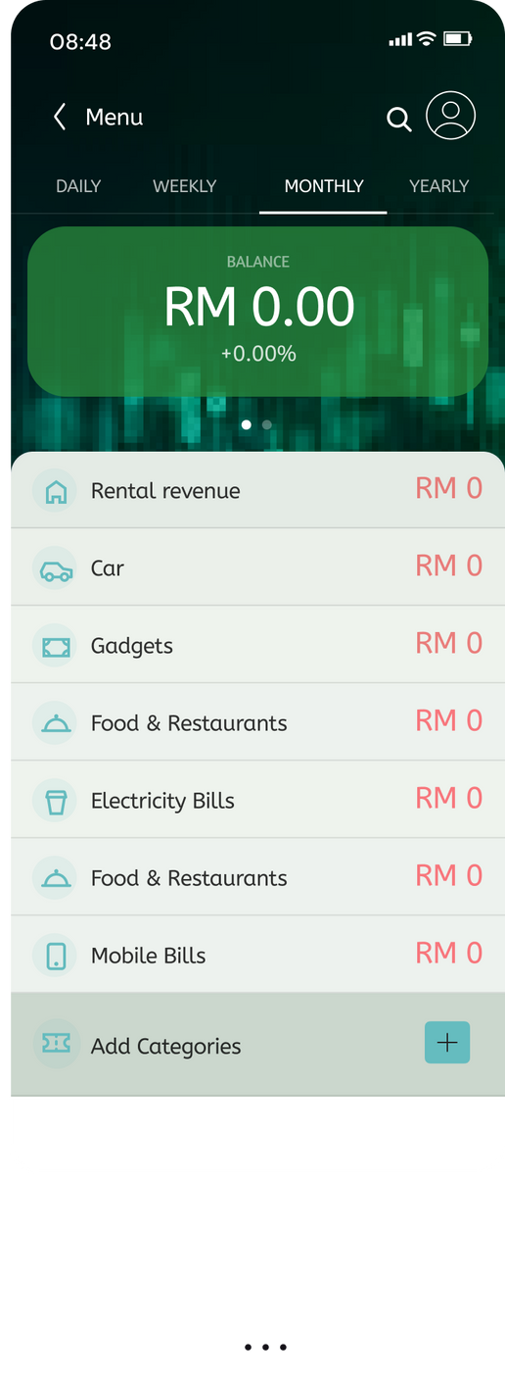
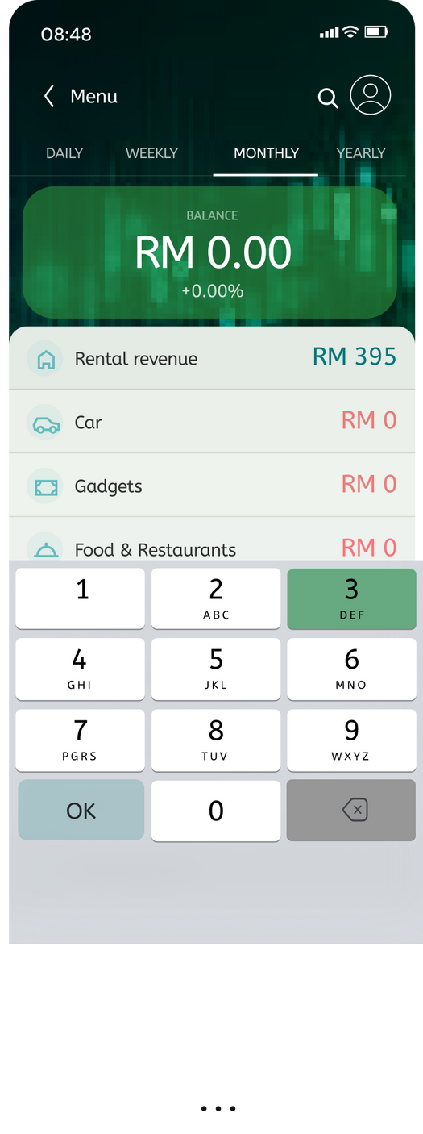
When the User clicks “Set Budget Plan” from Screen 2, Screen 3 appears.
Screen 3 contains the list of categories set up for planning the monthly budget of a user. It also contains “Add Categories” option for user to add categories according to convenience.
Screen 4 appears when user decides to put an amount to each category.
Screen 3
Screen 4
Set Budget Plan

Slide 15
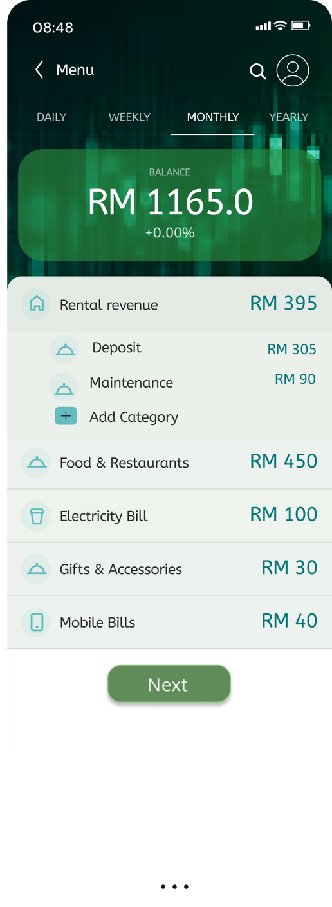
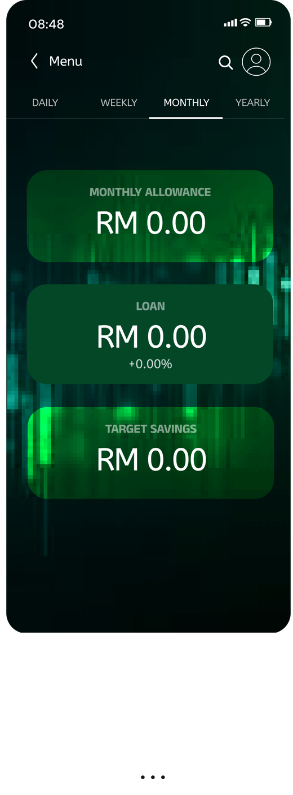
When the User clicks a single category from Screen 3, Screen 5 appears.
Screen 5 contains the list of sub-categories under each category. It also contains “Add Category” option for user to add sub categories according to convenience.
Screen 6 is the “Set target goal” screen, which contains three sectors for Users to set their target for the entire month.
Screen 5
Screen 6
Set Budget Plan

Slide 16
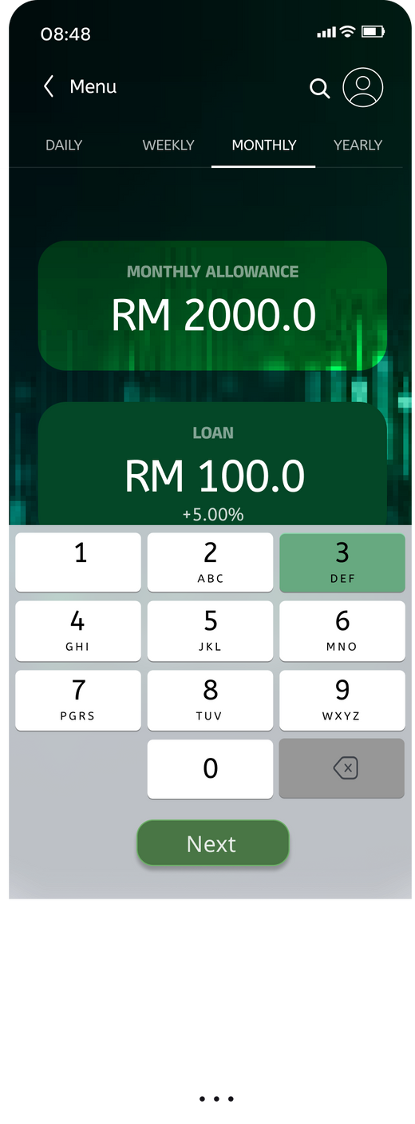
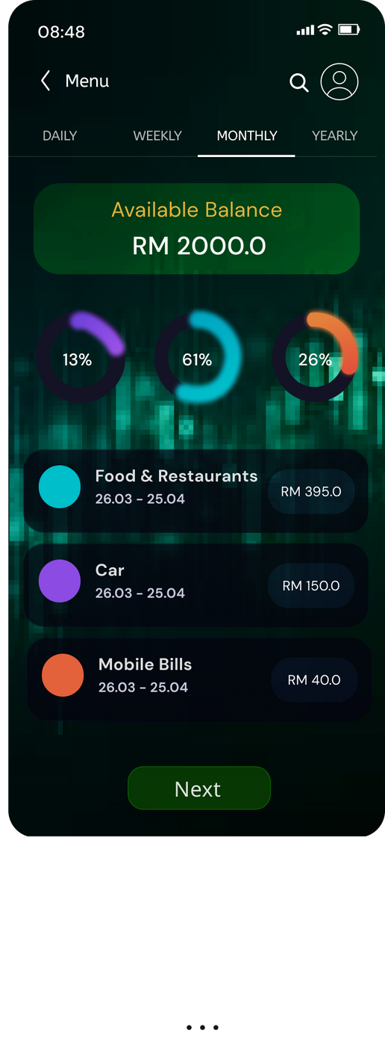
Screen 7 appears when user decides to put an amount to each category of “Set Target goal” screen.
Screen 8 is where a graphical representation of weightage of each category is shown, compared to the total Monthly Allowance. For existing users, this feature is kept for performance analysis.
Screen 7
Screen 8
Set Budget Plan

Slide 17
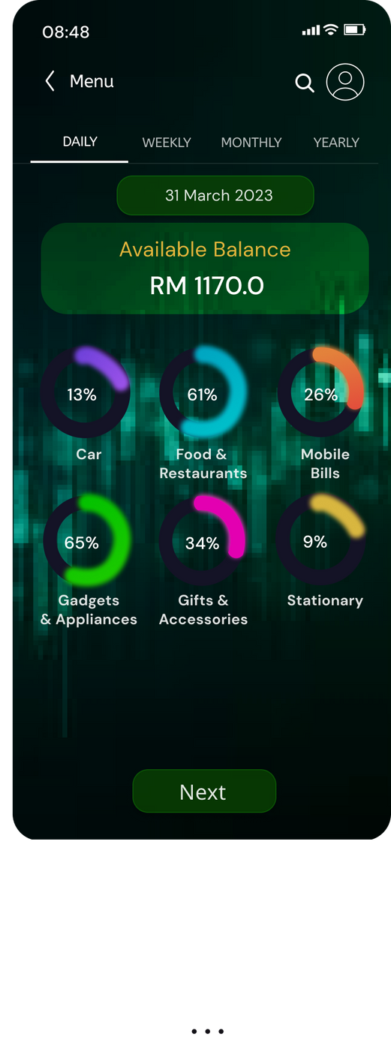
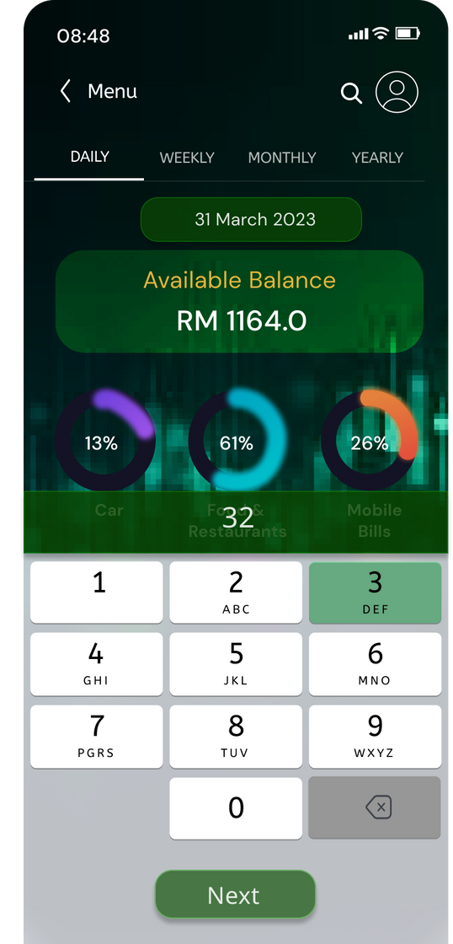
For a new user, Screen 9 appears when user decides to view status of each category in” Daily Allowance” dashboard.
For existing user, this is Screen 2. User views the status of money spent on each category in the dashboard.
Screen 10 appears when user decides to put an amount to each category in” Daily Allowance” dashboard.
Screen 9
Screen 10
Set Budget Plan

Slide 18
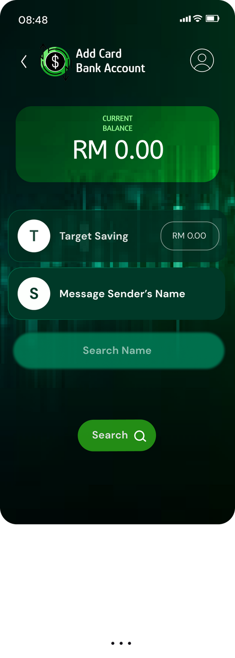
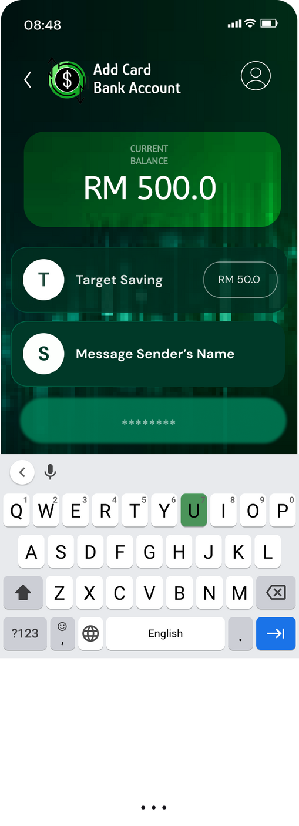
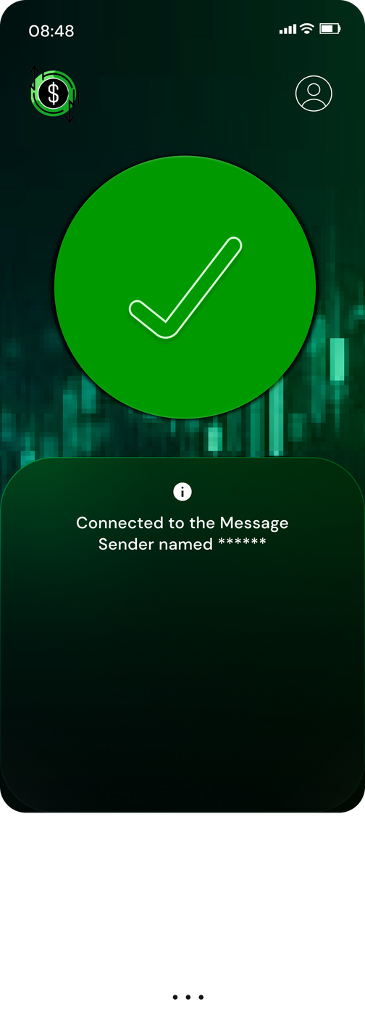
Add Card/Bank Account
Screen 11 appears when the user clicks “Add Card/Bank Account option” of Screen 2. It contains Current Amount in the bank, target Savings according to user, and the Message Sender’s name of the Banking App for BudgetBuddy to track ongoing and outgoing transactions.
Screen 12 appears when user decides to fill each category of Screen 11.
In Screen 13, a confirmation notification will be sent after the app detect the sender from Messages.
Screen 11
Screen 12
Screen 13

Slide 19
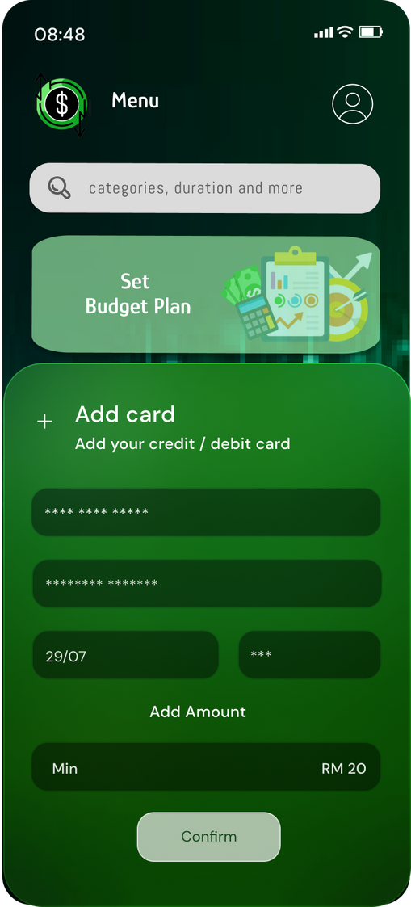
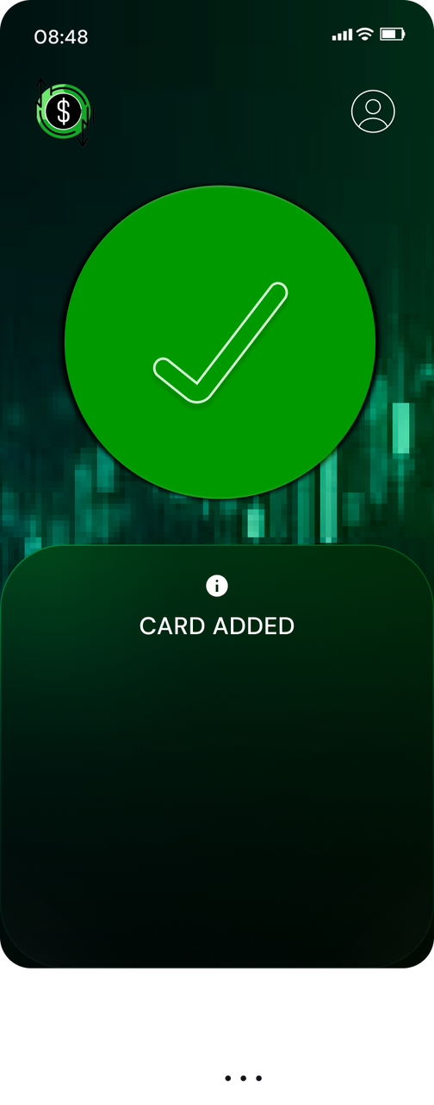
Screen 14 appears when the user clicks “OPPO Wallet” option of Screen 2. User enters the respective card number, CVV and min amount of RM 20 in OPPO Wallet to make it eligible.
In Screen 15, a confirmation notification will be sent after the app adds the card after the details have been inputted.
Screen 14
Screen 15
OPPO Wallet

Slide 20
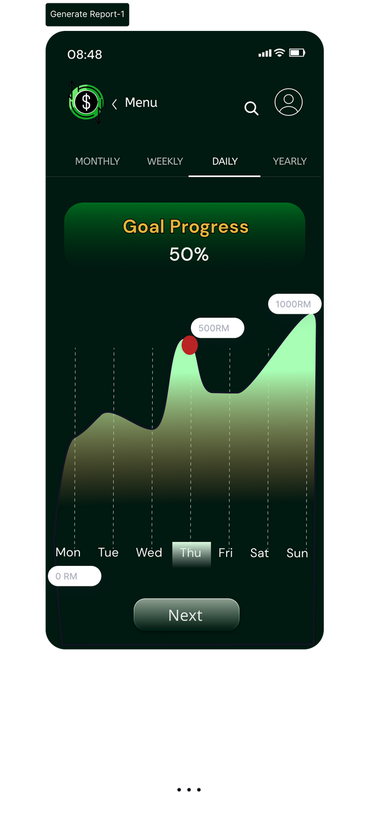
Screen 16 appears when the user clicks “Generate Report” option of Screen 2. This Screen represents Goal Progress and includes both the progress percentage and a graphical chart that illustrates daily, monthly, weekly and yearly progress.
Screen 16
Generate Report

Slide 21
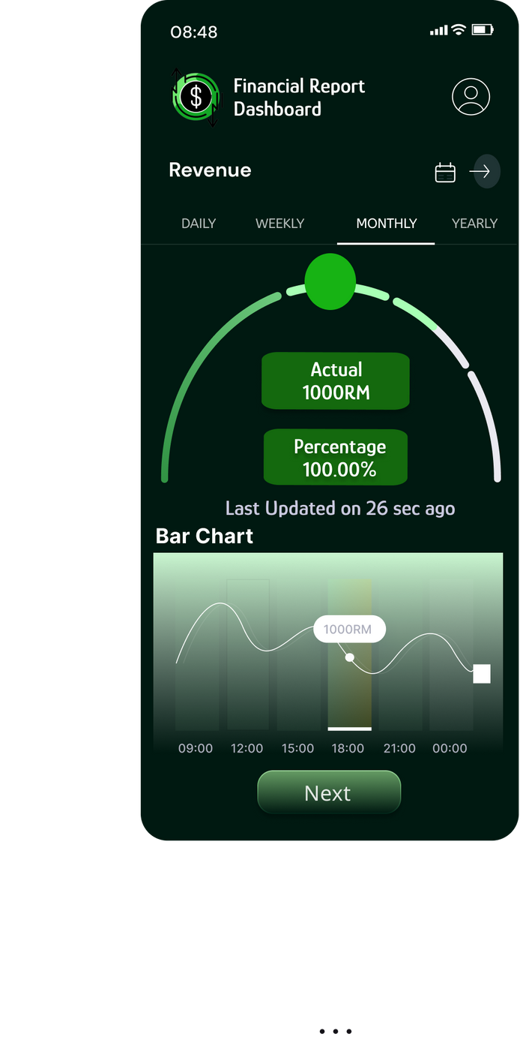

Screen 17 displays the monthly budget's Financial Report, featuring the actual budget alongside its corresponding percentage. Additionally, a bar chart visually tracks revenue progress and automatically updates whenever the user achieves their financial goals.
Screen 18 presents the Financial Report for expenses, allowing users to view cost ranges and monthly, daily, or yearly limits. Furthermore, the bar chart visually represents the user's current limit, providing a comprehensive overview of their spending.
Screen 17
Screen 18
Generate Report

Slide 22
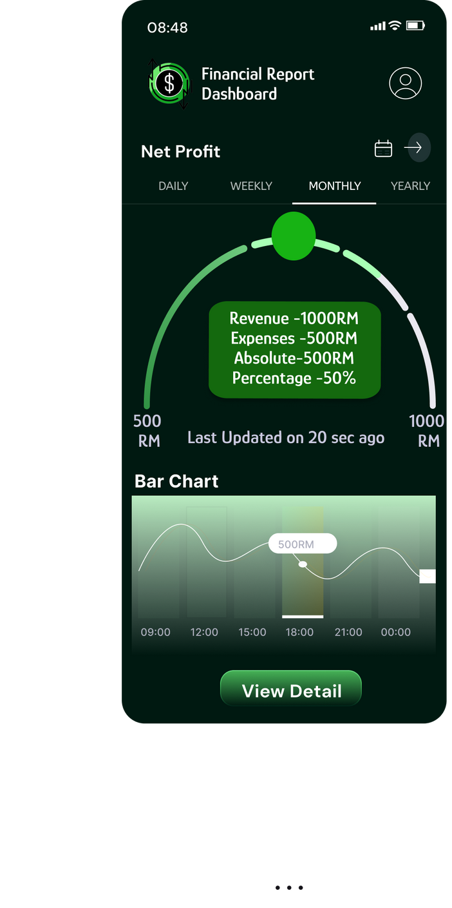
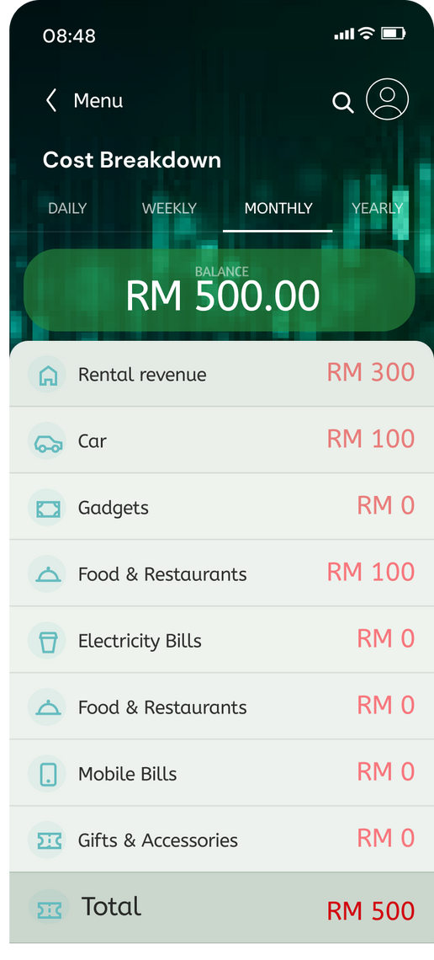
Screen 19 presents a Financial Report centered around net profit. It offers a comprehensive view of revenue and expenses, providing absolute amounts and their respective percentages. Additionally, the net profit section displays expense and revenue limits, while a bar chart tracks net profit progress.
If the user selects "View Detail," they can access the Cost Breakdown Screen 20, which showcases their current total balance and a detailed list of expenses with their corresponding amounts, giving a clear overview of total costs.
Screen 19
Screen 20
Generate Report

Slide 23
POST-TRIAL FEEDBACK FROM LOCAL USERS

Slide 24









Ariful Islam
30, Software Developer
Abu Talha Ibna Riaz Hassan
As a software developer, BudgetBuddy's expense categorization is a huge time-saver. The app's ability to seamlessly integrate with E-wallets is a fantastic feature. Setting monthly budgets for different expense categories will be a straightforward task. Excited to see the final version of this app!
Iftekhar Uddin Ahmed
22, Freelancer
23, Student
BudgetBuddy's transaction message integration is a game-changer! Based on the feature I have seen, I think It will effortlessly pull bank transactions from messages in the future, making budget tracking a breeze. The automatic categorization of expenses is spot-on, and the ability to customize categories gives me complete control. Looking forward to setting my monthly budgets!
BudgetBuddy understands the freelance lifestyle! The goal-setting feature is personalized and takes into account my income, expenses, and budget. The integration with OPPO Wallet and E-wallets will ensure that everyone can manage all of their transactions in one place. Looking forward to the full version of this app
Nuria Hanim
23, Student
Tahseen Sheefa
Md Syduzzaman
BudgetBuddy's integration with OPPO Wallet will align perfectly with today’s tech-centric lifestyle. The app's goal-setting feature provides a roadmap for financial success. The monthly reports offer a detailed breakdown, and the seamless E-wallet integration is a huge plus. Can't wait for future updates!
25, OPPO User and Early Adopter
40, Family Man
BudgetBuddy's transaction message integration is a game-changer! Based on the feature I have seen, I think It will effortlessly pull bank transactions from messages in the future, making budget tracking a breeze. The automatic categorization of expenses is spot-on, and the ability to customize categories gives me complete control. Looking forward to setting my monthly budgets!
Managing a family budget is no easy task, but BudgetBuddy makes it manageable. The app's ability to categorize expenses and set family goals is fantastic. The integration with E-wallets will certainly ensure that every family member's transactions are accounted for. Excited to see the main version of this app!

Slide 25


Together, we aim to build a convenient solution for better lifestyle management of OPPO users!
THANK YOU
We hope you like it!

